Slide 1
CSC589 Introduction to Computer Vision Lecture 9
Sampling, Gaussian Pyramid
Bei Xiao

Slide 2
What we have learned so far
Image contrast, histograms, and basic manipulation
Image Convolution
Image Filters
Fourier transform
Filtering in Fourier transform

Slide 3
What we want to achieve in this course?
Basic image processing (extract contours, boundaries, edges).
Basic understanding of image formation (camera models, projection)
Basic skills of image synthesizing (textures, panorama images, image hybrid, stereo)
Basic understanding of image features (HOG, SIFT, optical flow).
Basic exposure of the state of the art computer vision applications.
Brushing up numerical Python skills
(multiple object tracking, segmentation, 3D construction, recognition of objects and faces)
Application of machine learning in CV (Clustering, Bayesian, deep learning intro).
Basic mathematical concepts behind image processing (Fourier transform, convolution, probability and statistics ).
If you have made progress in at least 4 out of the above points, it is a success!

Slide 4
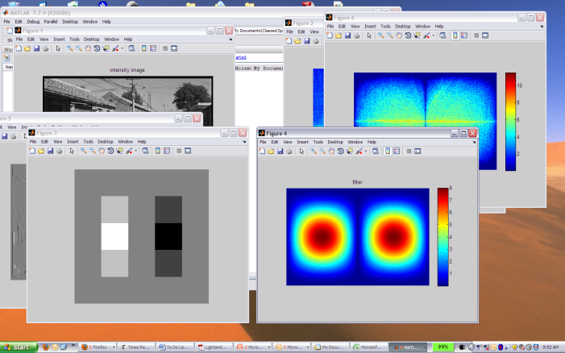
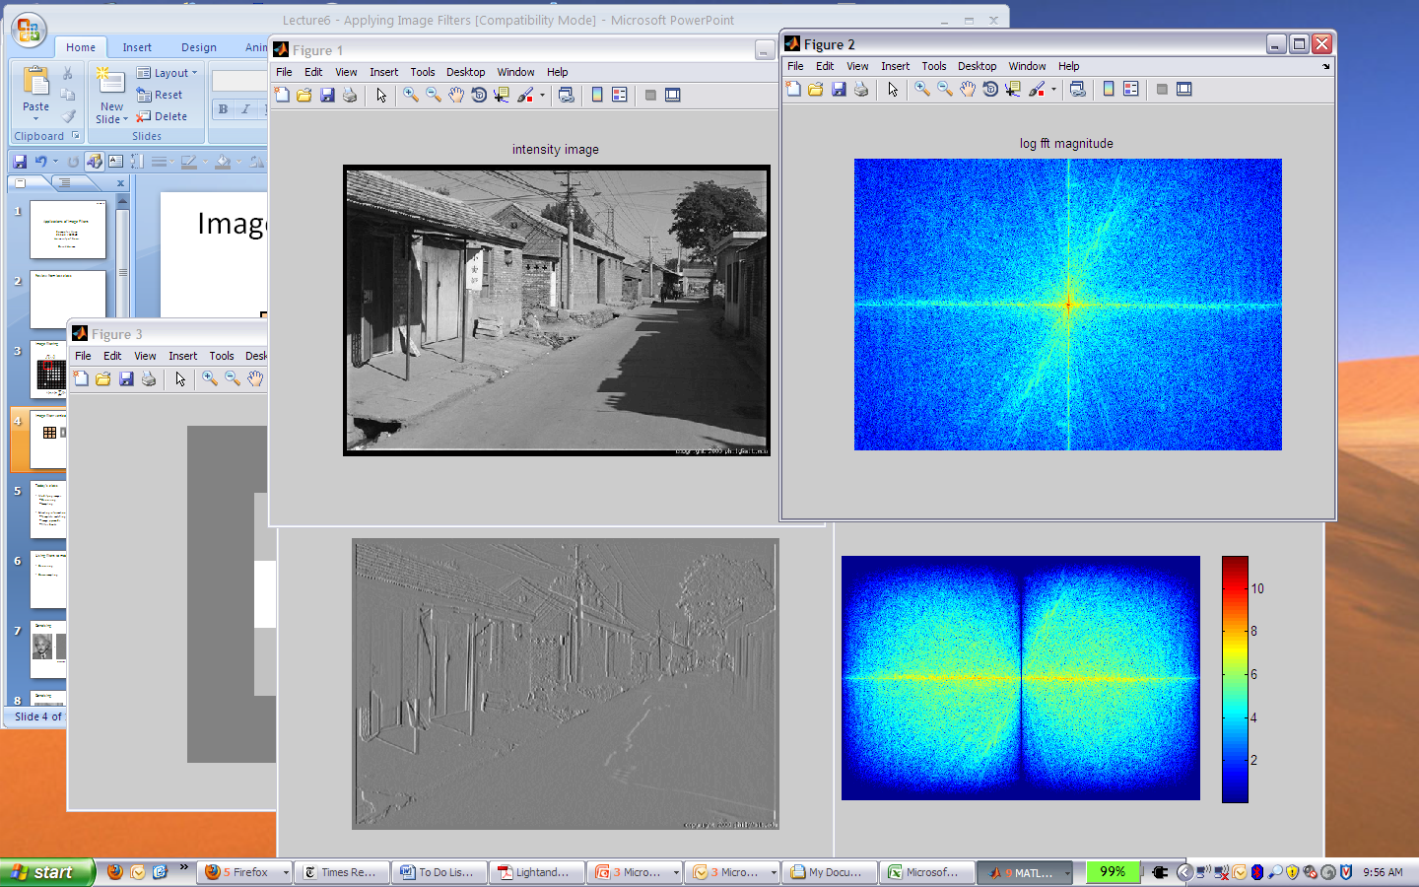

Filtering in frequency domain
FFT
FFT
=
Inverse FFT
Slide: Hoiem

Slide 5
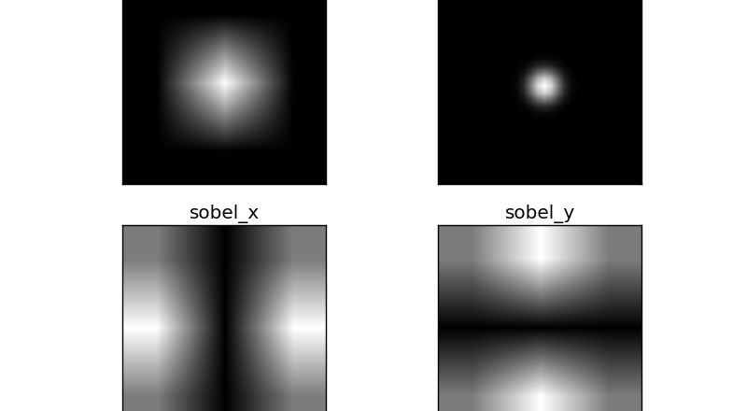
Filters in Fourier Domain
Mean filter
Gaussian Filter

Slide 6


Sampling
Why does a lower resolution image still make sense to us? What do we lose?
Image: http://www.flickr.com/photos/igorms/136916757/

Slide 7
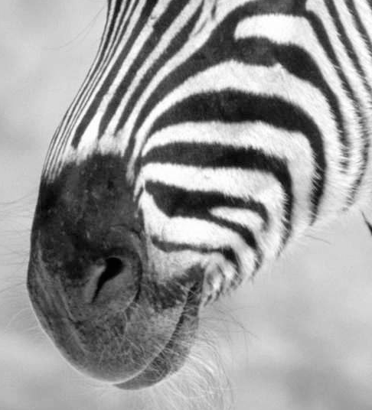
Subsampling by a factor of 2
Throw away every other row and column to create a 1/2 size image

Slide 8
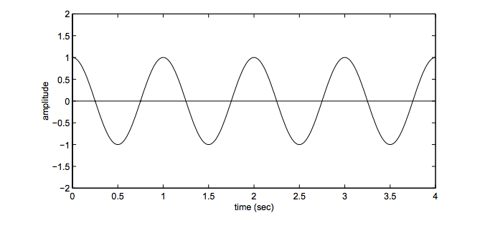
Aliasing problem
1D example (sinewave):
http://redwood.berkeley.edu/bruno/npb261/aliasing.pdf

Slide 9
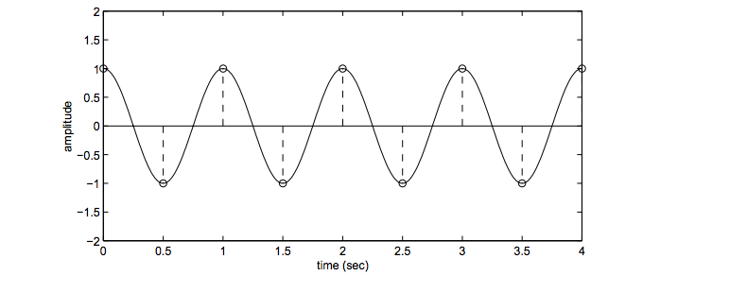
Aliasing problem
1D example (sinewave):
Sample at 2Hz
http://redwood.berkeley.edu/bruno/npb261/aliasing.pdf

Slide 10
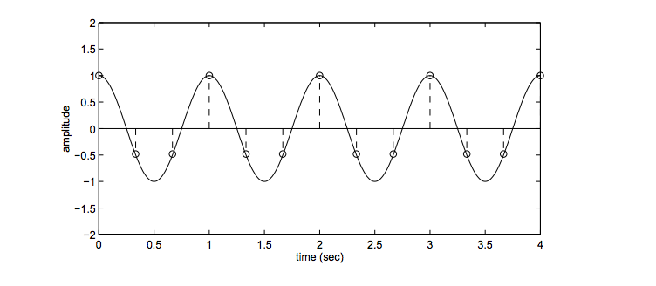
Aliasing problem
1D example (sinewave):
Sample at 3Hz
http://redwood.berkeley.edu/bruno/npb261/aliasing.pdf

Slide 11
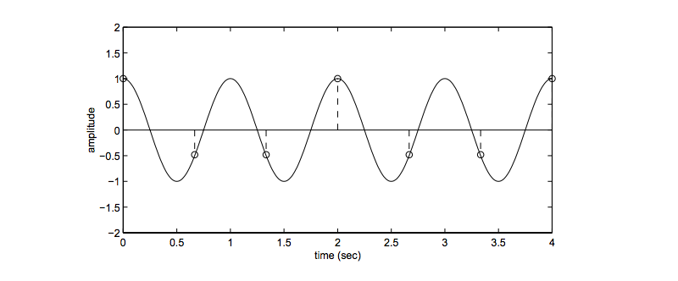
Aliasing problem
1D example (sinewave):
Sample at 1.5 Hz
http://redwood.berkeley.edu/bruno/npb261/aliasing.pdf

Slide 12
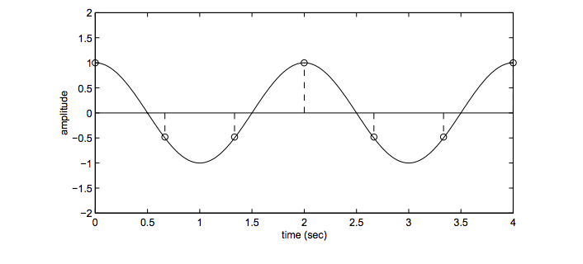
Aliasing problem
1D example (sinewave):
Sample at 1.5 Hz
http://redwood.berkeley.edu/bruno/npb261/aliasing.pdf

Slide 13
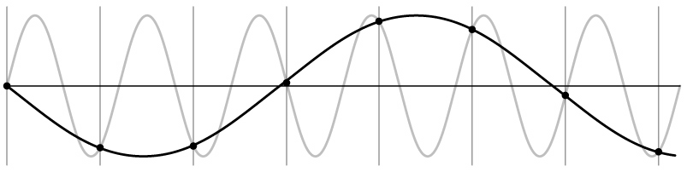
Aliasing problem
1D example (sinewave):
Insufficient sampling can’t distinguish two wave forms!
http://redwood.berkeley.edu/bruno/npb261/aliasing.pdf

Slide 14
Aliasing problem
Sub-sampling may be dangerous….
Characteristic errors may appear:
“Wagon wheels rolling the wrong way in movies”
“Checkerboards disintegrate in ray tracing”
“Striped shirts look funny on color television”
Source: D. Forsyth

Slide 15
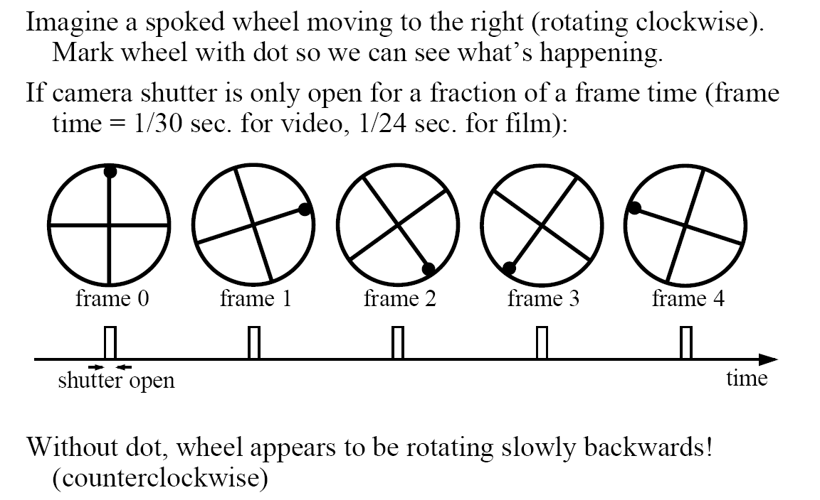
Aliasing in video
Visual illusion: http://www.michaelbach.de/ot/mot-wagonWheel/index.html
Slide by Steve Seitz

Slide 16
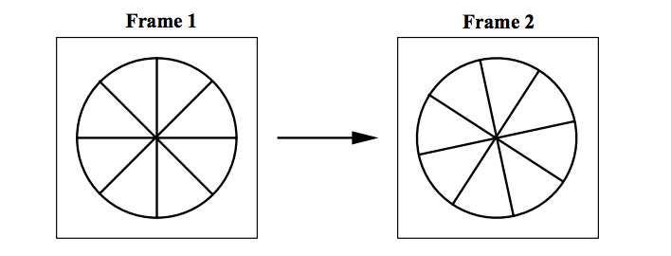
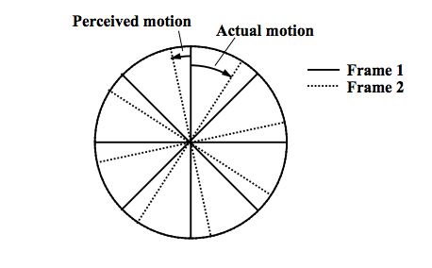
Aliasing in video
http://redwood.berkeley.edu/bruno/npb261/aliasing.pdf
Notes:
The problem the brain faces in viewing these frames in rapid succession is that there are two interpretations. One interpretation is that the wheel has moved by 83% of the spoke interval in the clockwise direction. The alternative interpretation is that it has moved by 17% of the spoke interval in the counter-clockwise direction. It turns out that the brain prefers the latter interpretation, and so as a result you perceive the wheel moving backwards (counter-clockwise) at a slower speed than it is actually moving:

Slide 17
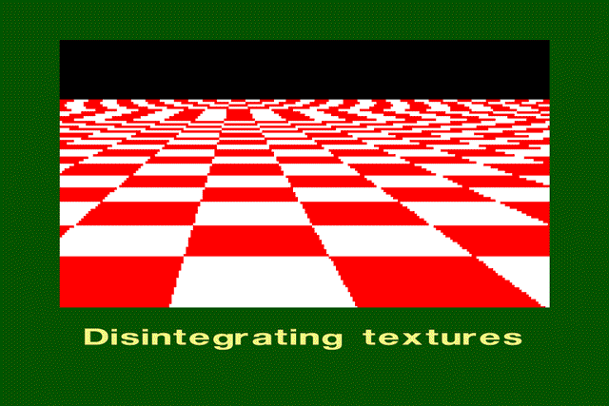
Aliasing in graphics
Source: A. Efros

Slide 18
Sampling and aliasing

Slide 19
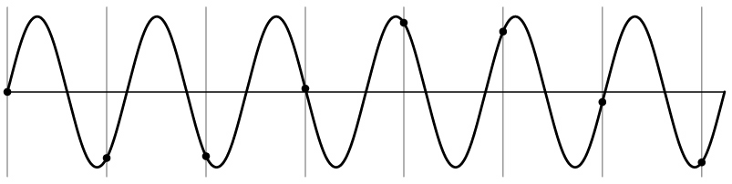
Nyquist-Shannon Sampling Theorem
When sampling a signal at discrete intervals, the sampling frequency must be ≥ 2 × f_{max}
f_{max} = max frequency of the input signal
This will allows to reconstruct the original perfectly from the sampled version
v
v
v
good
bad

Slide 20
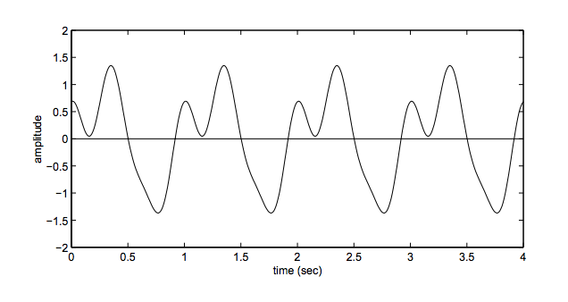
Aliasing problem
How many frequency should we sample?
1hz, 2hz, 3hz sin waves adding together
http://redwood.berkeley.edu/bruno/npb261/aliasing.pdf

Slide 21
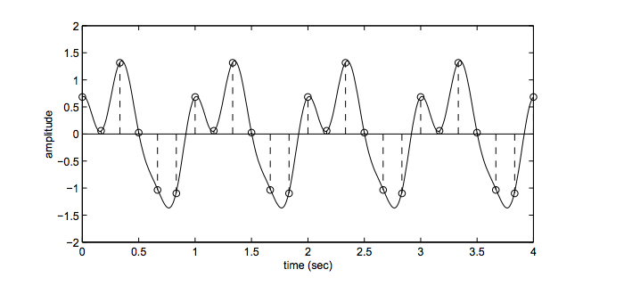
Aliasing problem
How many frequency should we sample?
Sampling: 2 x highest frequency
http://redwood.berkeley.edu/bruno/npb261/aliasing.pdf

Slide 22
Anti-aliasing
Solutions:
Sample more often
Get rid of all frequencies that are greater than half the new sampling frequency (low pass filtering)
Will lose information
But it’s better than aliasing
Apply a smoothing filter

Slide 23
Algorithm for downsampling by factor of 2
Start with image(h, w)
Apply low-pass filter
im_blur = ndimage. filters_ gaussian_filter (image, 7)
Sample every other pixel
im_small = im_blur[::2; ::2];

Slide 24
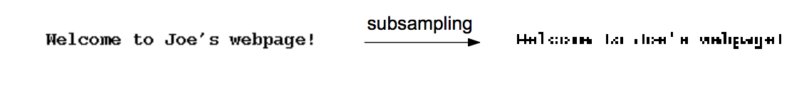
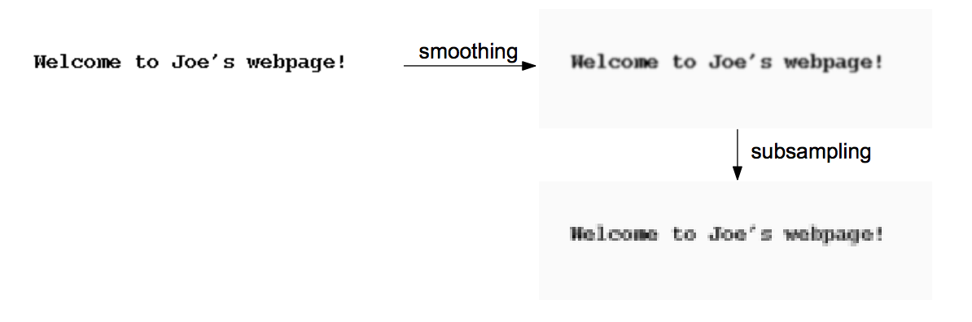
Text images

Slide 25
Anti-aliasing
Forsyth and Ponce 2002

Slide 26
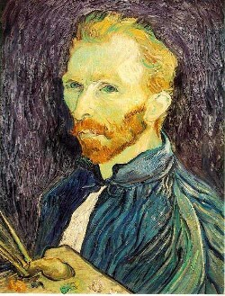
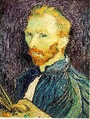

Subsampling without pre-filtering
1/2
1/4 (2x zoom)
1/8 (4x zoom)
Slide by Steve Seitz

Slide 27



Subsampling with Gaussian pre-filtering
Gaussian 1/2
G 1/4
G 1/8
Slide by Steve Seitz

Slide 28
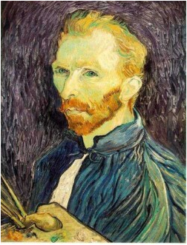


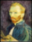


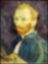
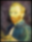
Gaussian pre-filtering
Solution: filter the image, then subsample
F₀
F₁
F₂
…
blur
subsample
blur
subsample
F₀ H
F₁ H
*
*

Slide 29
{
Gaussian pyramid
F₀
F₁
F₂
…
blur
subsample
blur
subsample
F₀ H
F₁ H
*
*

Slide 30
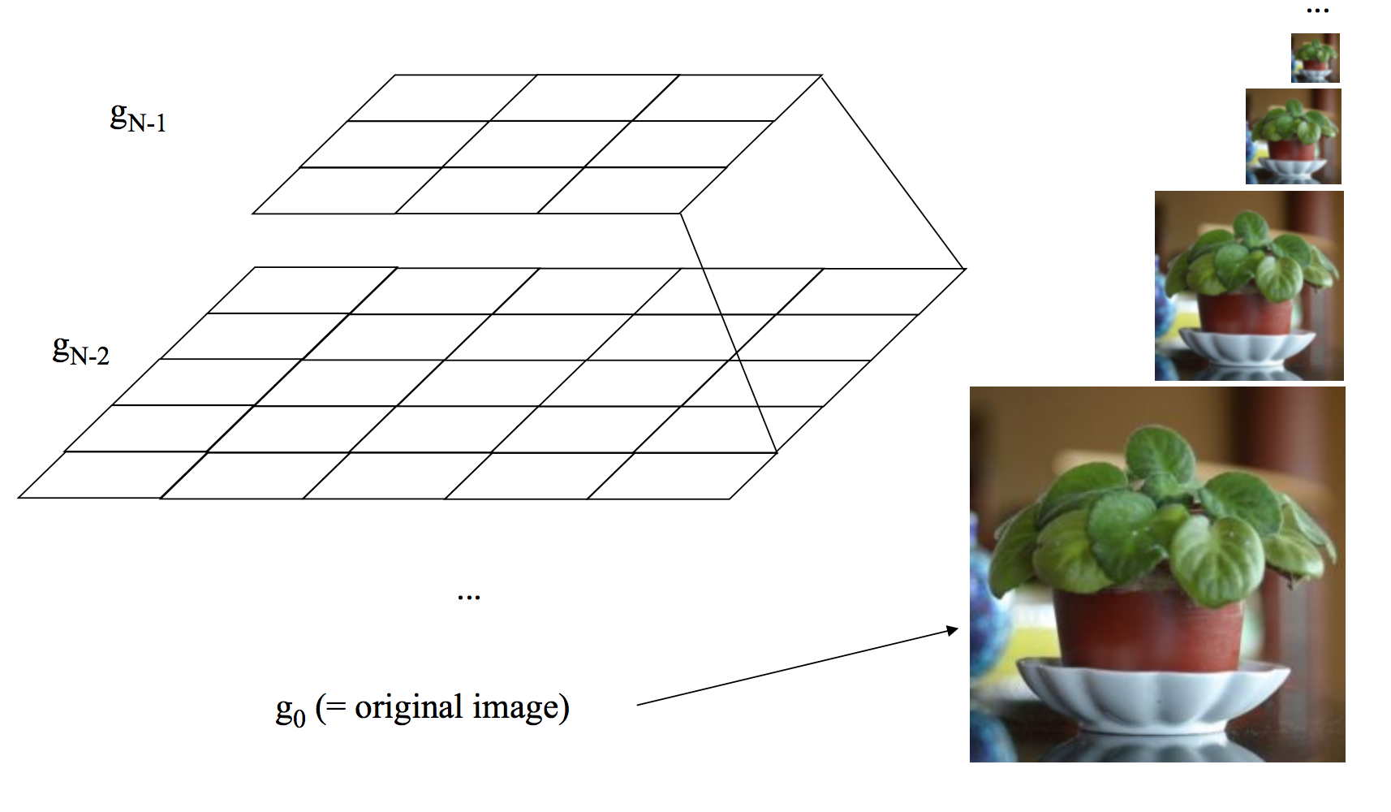
Why is it called a pyramid
Idea: Representation can be pictured as a “pyramid” of 3×3, 5×5, 9×9, …, (2^{n}+1)(2^{n}+1) images.

Slide 31
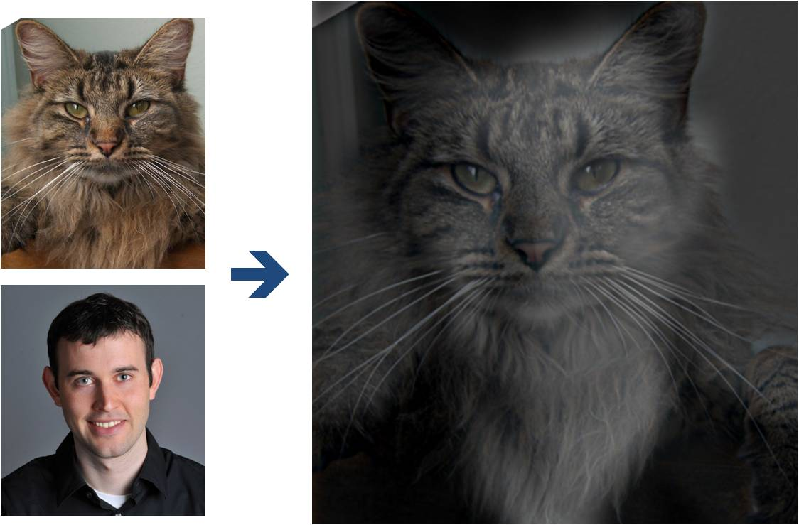
Why do we get different, distance-dependent interpretations of hybrid images?
?

Slide 32
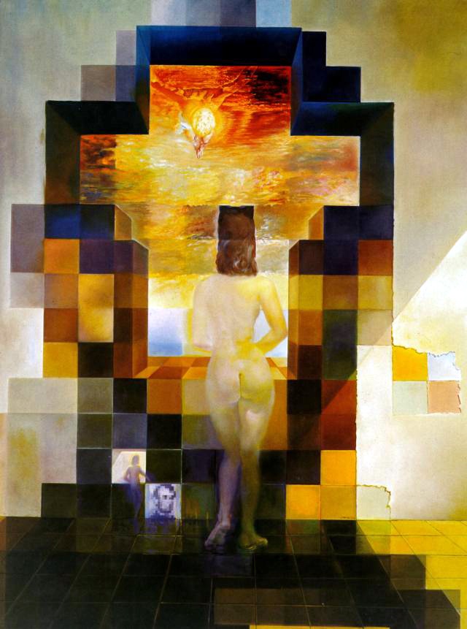
Salvador Dali invented Hybrid Images?
Salvador Dali
“Gala Contemplating the Mediterranean Sea,
which at 30 meters becomes the portrait
of Abraham Lincoln”, 1976

Slide 33
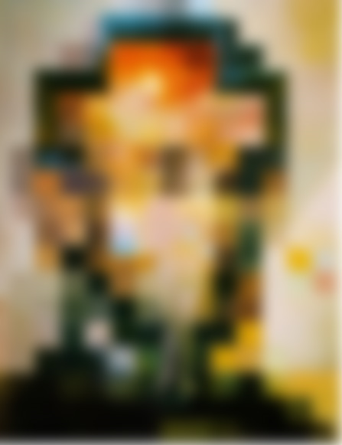

Slide 35
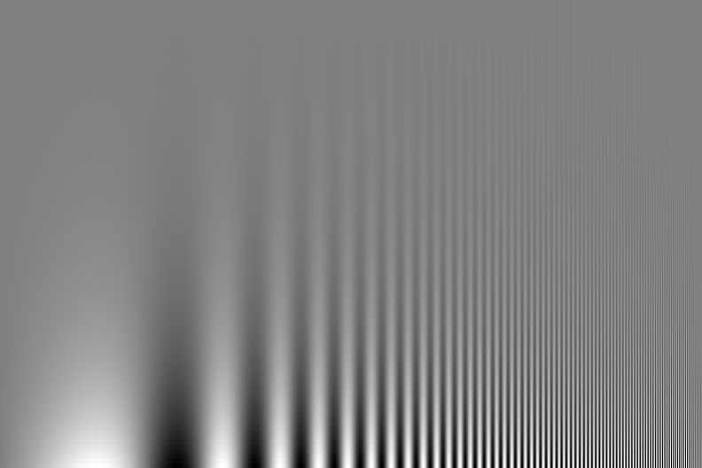
Campbell-Robson contrast sensitivity curve defines your window of sensitivity
contrast
Spatial frequency
Region of visibility
Further reading:
http://www.psy.vanderbilt.edu/courses/hon185/SpatialFrequency/SpatialFrequency.html
Notes:
In the figure above, spatial frequency increases as you look from left to right (the bars become thinner and thinner) and contrast decreases as you look from bottom to top (bars become more difficult to see). From a fixed viewing distance, notice over the range of spatial frequencies the contrast values where the bars are just barely visible - imagine placing a curve along those points of threshold visibility. You'd trace out an inverted U-shaped curve. This is your contrast sensitivity function.

Slide 36
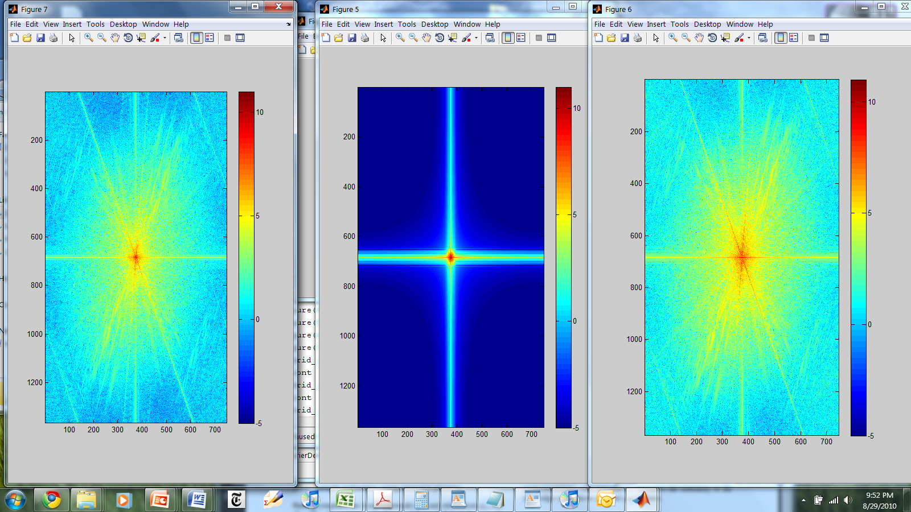
Hybrid Image in FFT
Hybrid Image
Low-passed Image
High-passed Image

Slide 37
Perception
Why do we get different, distance-dependent interpretations of hybrid images?
?

Slide 38
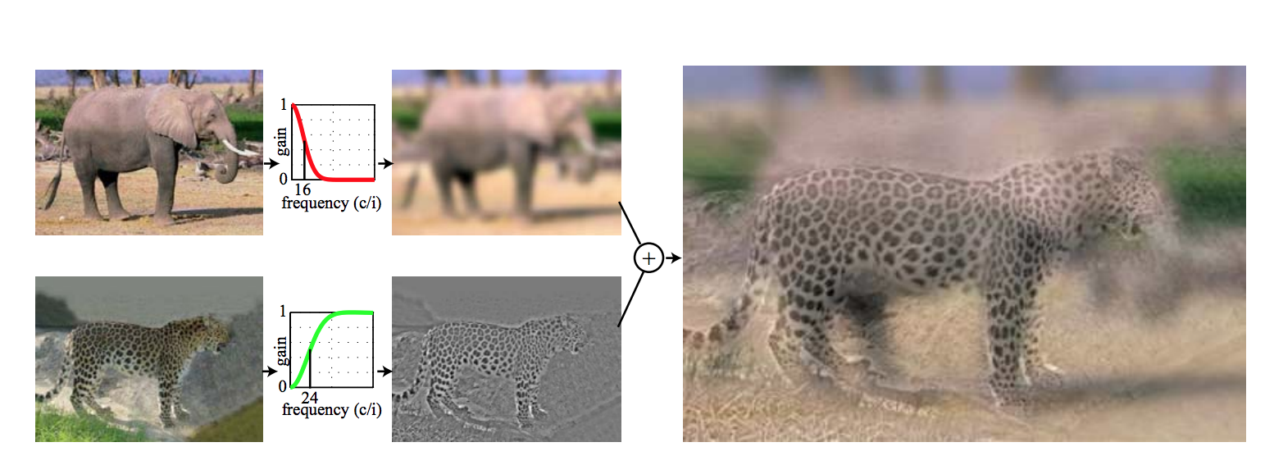
Please read the original paper:
http://cvcl.mit.edu/hybrid/OlivaTorralb_Hybrid_Siggraph06.pdf
Gaussian filters

Slide 39
Please read the original paper:
http://cvcl.mit.edu/hybrid/OlivaTorralb_Hybrid_Siggraph06.pdf
Cut-off frequency
Gaussian filters
Both image size and the cut-off frequency matter!

Slide 40
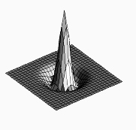

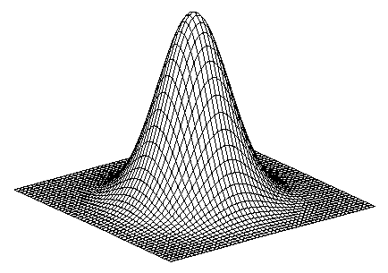
Laplacian filter
unit impulse
Gaussian
Laplacian of Gaussian
Source: Lazebnik

Slide 41
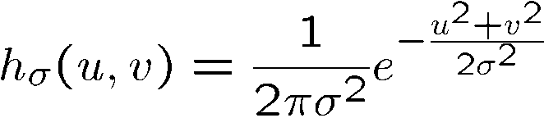
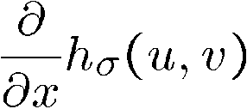
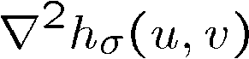
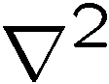
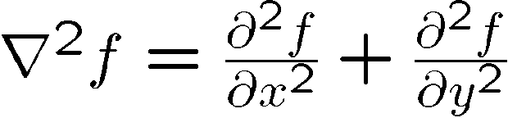
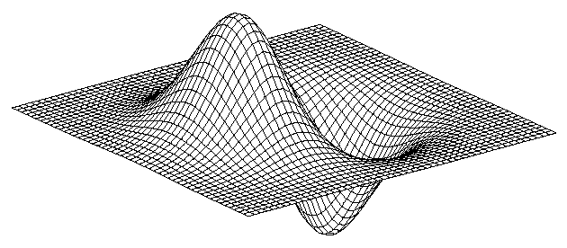
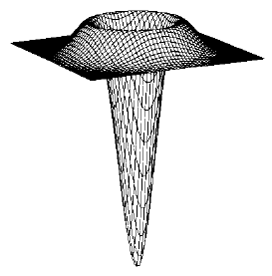
2D edge detection filters
Laplacian of Gaussian
Gaussian
derivative of Gaussian
is the Laplacian operator:
scipy.ndimage.filters.laplace
Notes:
How many 2nd derivative filters are there? There are four 2nd partial derivative filters.
In practice, it’s handy to define a single 2nd derivative filter—the Laplacian

Slide 42
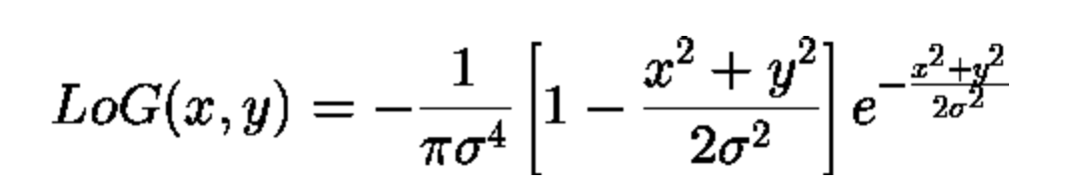
Laplacian of Gaussian
In Python:
result = ndimage.filters.laplace(img)
scipy.ndimage.filters.laplace
Notes:
How many 2nd derivative filters are there? There are four 2nd partial derivative filters.
In practice, it’s handy to define a single 2nd derivative filter—the Laplacian

Slide 43
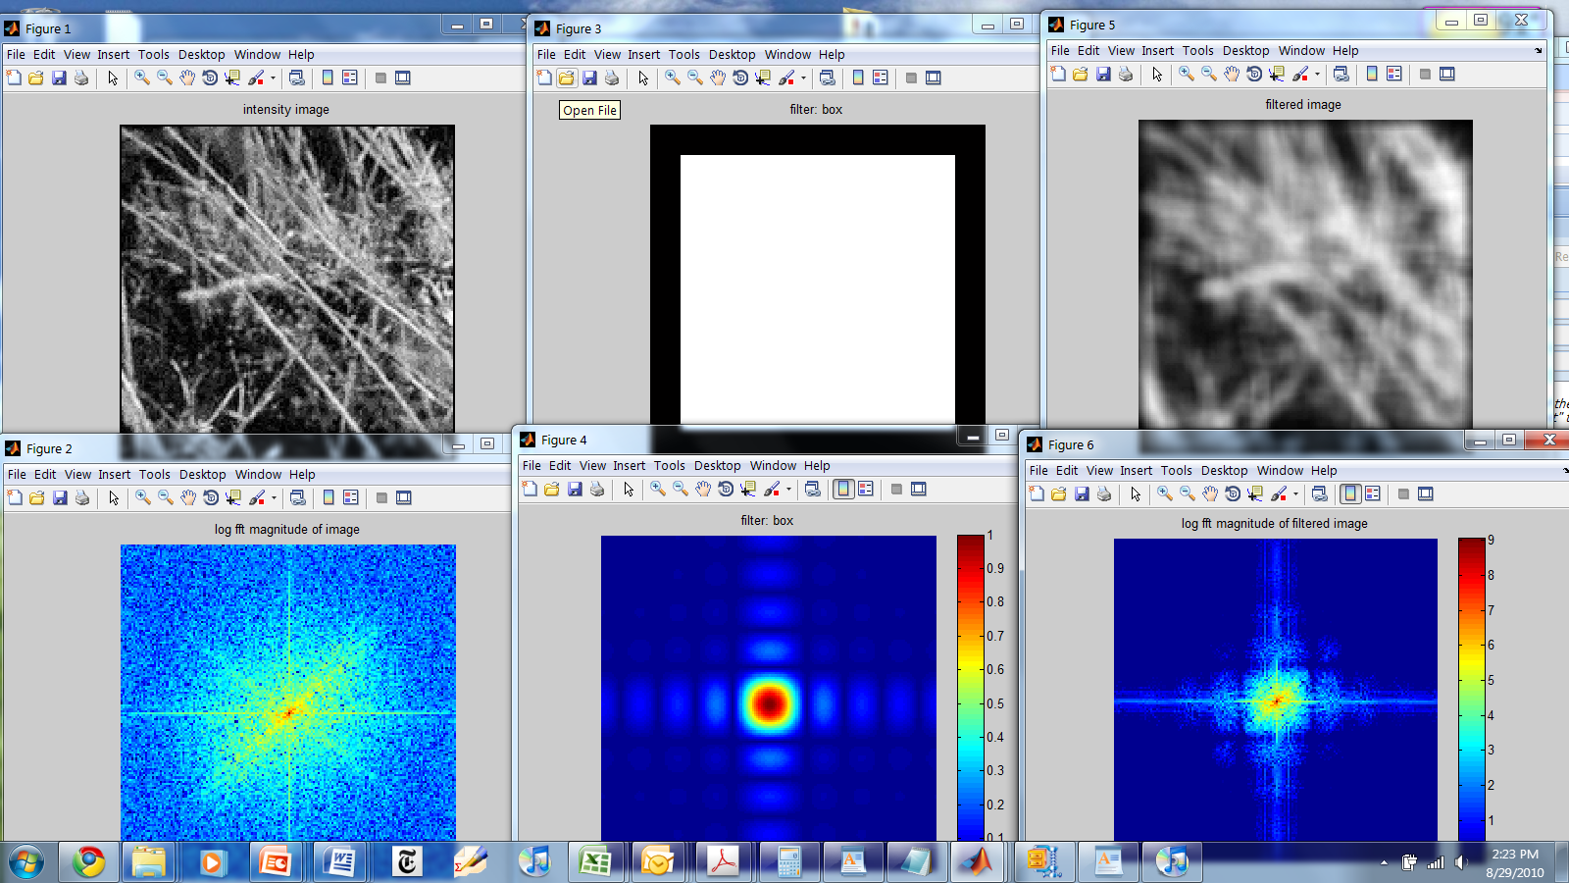
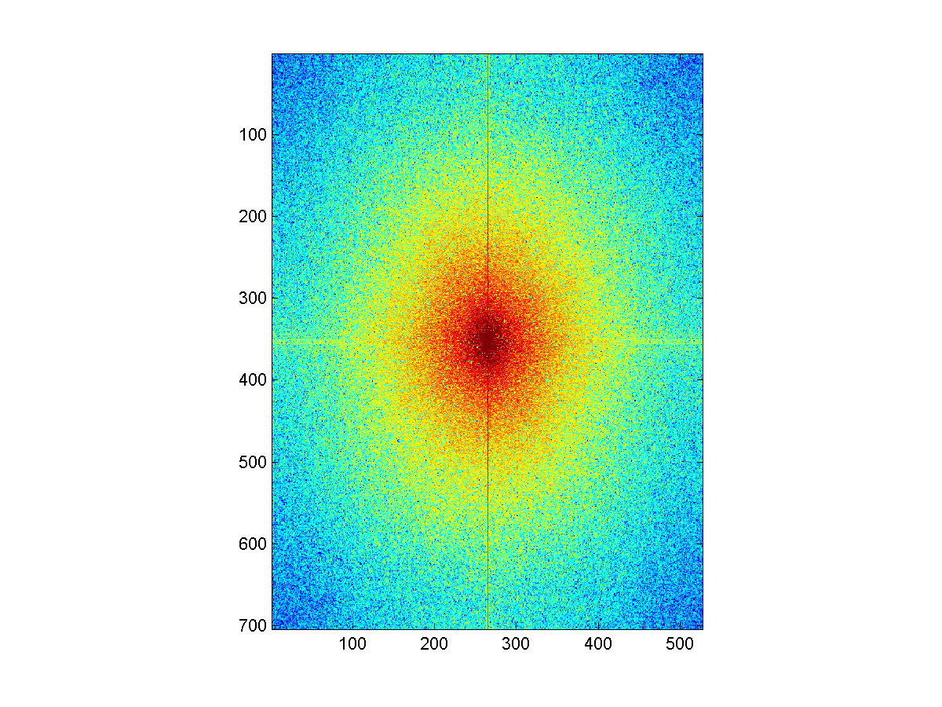
Things to Remember
Sometimes it makes sense to think of images and filtering in the frequency domain
Fourier analysis
Can be faster to filter using FFT for large images (N logN vs. N² for auto-correlation)
Images are mostly smooth
Basis for compression
Remember to low-pass before sampling

Slide 44
Take home reading
Aliasinghttp://redwood.berkeley.edu/bruno/npb261/aliasing.pdf
Hybrid images
http://cvcl.mit.edu/hybrid/OlivaTorralb_Hybrid_Siggraph06.pdf
Fourier Transform: Chapter 3.4
Next class: Gaussian Pyramids, Filter banks and Texture

